Slide 1
Thyroid Condition-Data Science
Project Owner
Venkat Murali
Mentored by
Mr P.V Subramanian
Notes:
Data Collection was a big challenge in the medical device and pharmaceutical industry

Slide 2
AGENDA
Hypothyroidism
EDA – Tableau & Python
Data Pre processing
Logistic Regression
CART
Performance Measures
Need for study

Slide 3
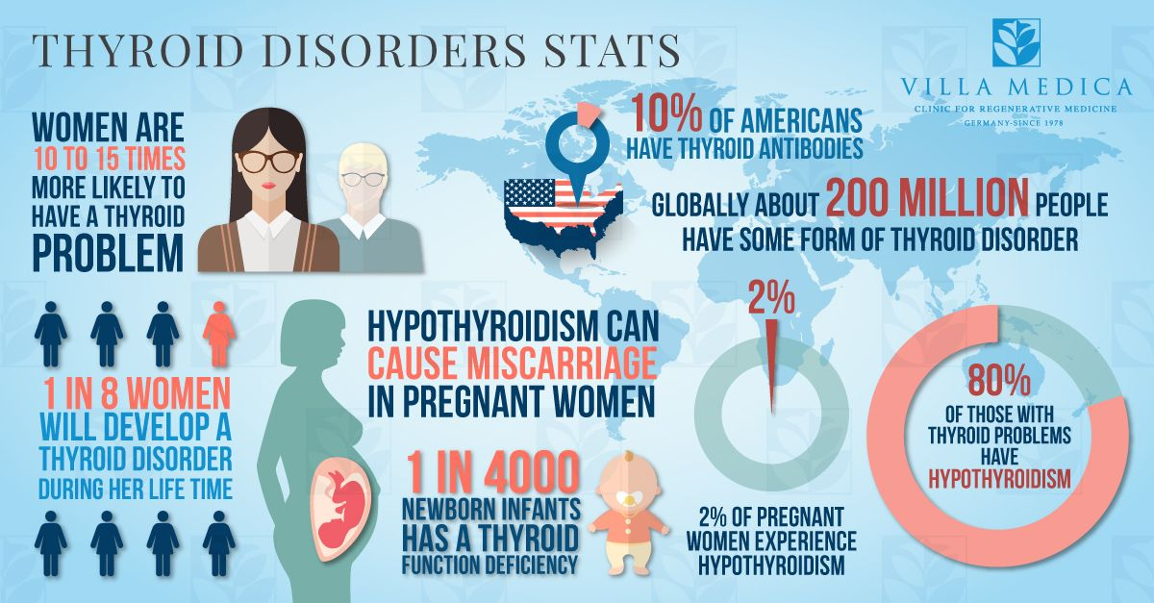
Application of Analytics in Life Science
Modern world and Smart Customers require health condition at fingertips
Pharma companies have to come up with new tools to keep pace with customer and coming up with preventive tools
Insights from Analytics can be used by Life Sciences sector into its basic operating model for defining their strategy
In this project , We look at one such application of Analytics to predict hypothyroid condition in patients

Slide 4
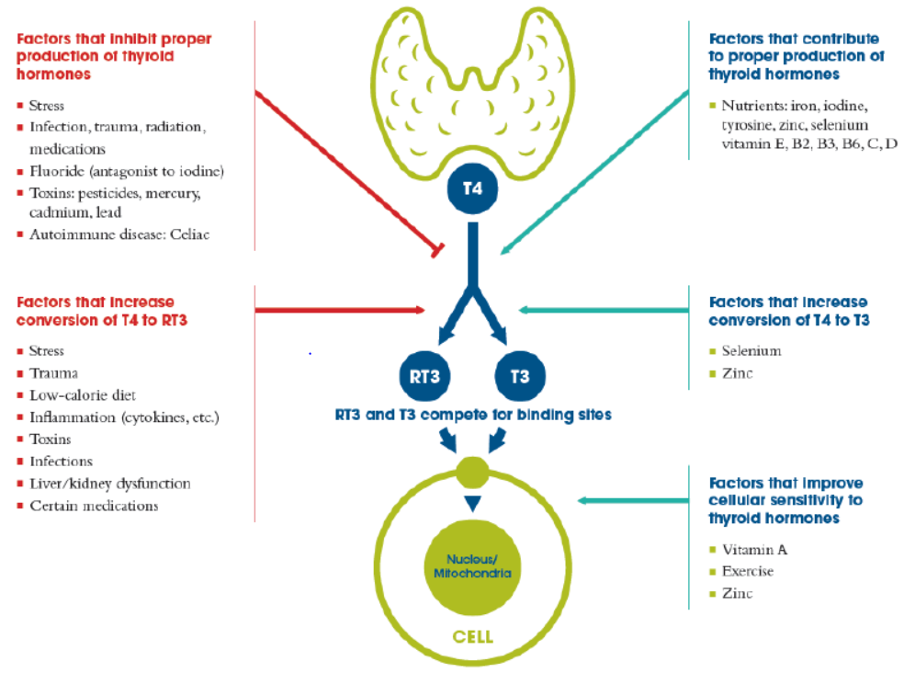
Need for study
Our objective is to accurately predict the hypothyroidism in Patients with the various factors available
And predict the exact cause for the occurrence of Hypothyroidism in Patients

Slide 5
Data Source
Data Structure : Sample
Data source link:
VM Ware Client

Slide 6
EXPLORATORY DATA ANALYSIS
As part of EDA , below activities were performed
EDA Using Tableau
EDA Using Python
Data Pre Processing
Feature Selection

Slide 7
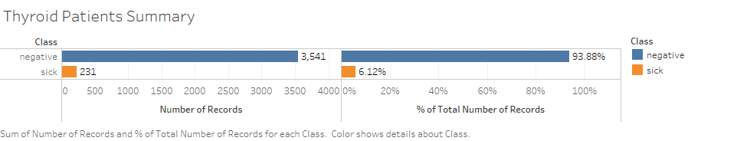
EDA -Tableau
Patient Summary :

Slide 8
EDA
Pandas Profiling Report :
Observations from Profile Report:
There are number of missing values denoted by ‘?’ in the dataset for the Numerical variables
All the Hormone levels that are not collected are represented as ‘?’
There is high Cardinality relation among the Numeric Variables
Column ‘TBG’ has missing values for all the Patients and hence we can remove the column for further processing of the dataset
Also, Column ‘TBG Measured’ has constant value as ‘f’ as no data is collected for any patients and hence that column also can be removed for further processing
During Data understanding, we have also understood that all the variables are present as object variables. Model Building would fail if datatypes are not converted
Hence proper data transformation has to be done to all the variables before imputing the missing values
Label Encoder -> For all the Categorical variables
Target Variable Transformation
Data type conversion for the Numeric Variables

Slide 9
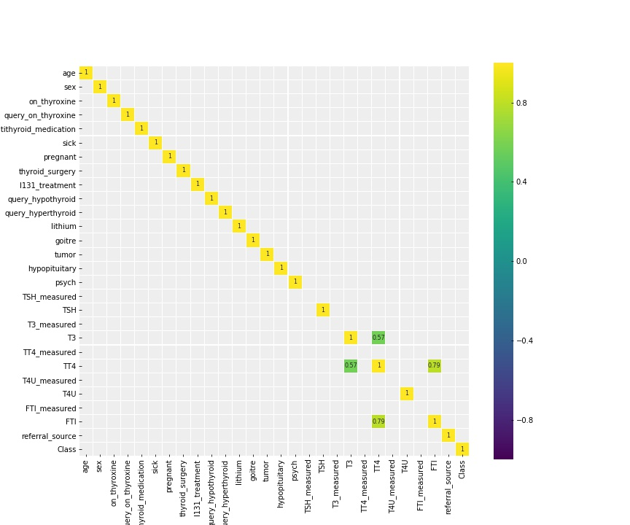
Feature Selection
From EDA , Presence of unwanted and irrelevant data is evident which may reduce the accuracy of the data during Model Building
So Feature Selection is adopted to remove the columns and build the model only with relevant data
From the graph, we can see that only TT4 and FTI are highly correlated and no other variables exhibit strong correlation
Correlation Plot Among Independent Variables

Slide 10
CORRELATION WITH TARGET VARIABLE
Correlation Coefficient | Output | Observation
Corr Coef > 0.5 | There is 0 strongly correlated values with Class: Series([], Name: Class, dtype: float64) | There is not even a single variable that has a higher correlation co-efficient with the Target Variable ‘Binary Class’
Corr Coef > 0.1 | There is 4 strongly correlated values with Class: age 0.161450 TT4 -0.125715 T4U -0.241457 T3 -0.394737 Name: Class, dtype: float64 | T3 has the highest correlation coefficient All are Numerical Variables
Corr_coeff > 0.05 | There is 7 strongly correlated values with Class: age 0.161450 sick 0.099155 query_hypothyroid 0.083649 hypopituitary 0.065001 TT4 -0.125715 T4U -0.241457 T3 -0.394737 Name: Class, dtype: float64 | This is just done to have wider set of categories to see if any categorical becomes significant. We can see that few categorical variables that are also related

Slide 11
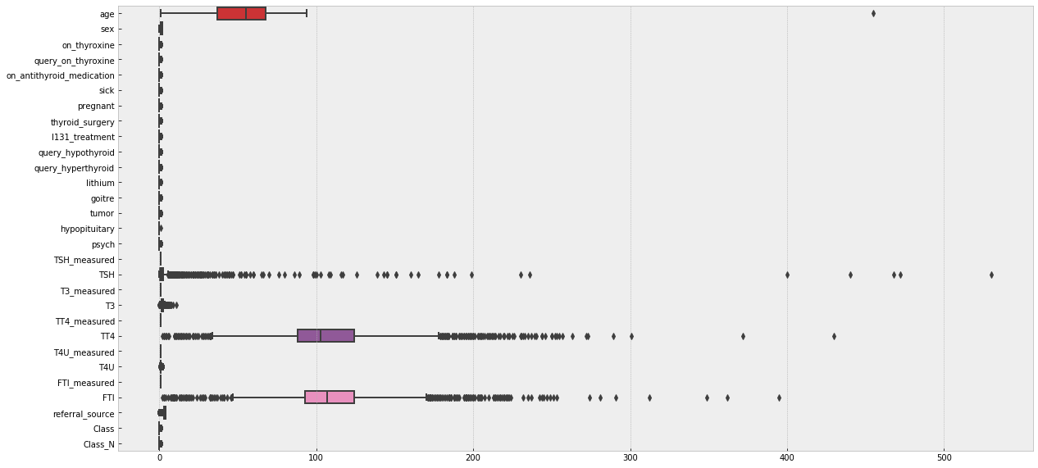
Feature Selection - Box Plot
Box plot of the Data Set :
Only Numerical Variables play a role in the prediction of thyroid in patients
i.e the Measurement of TSH, T3, T4U,FTI Harmone levels

Slide 12
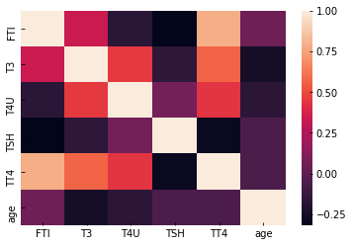
Logistic Regression model
Assumptions :
Binary Target Variable
Absence of Multicollinearity
Linearity of the odds
Large Number of Observations
Multicollinearity Among Numeric Variables
Finding :
TT4 and FTI are the two Numeric Variables that are strongly correlated

Slide 13
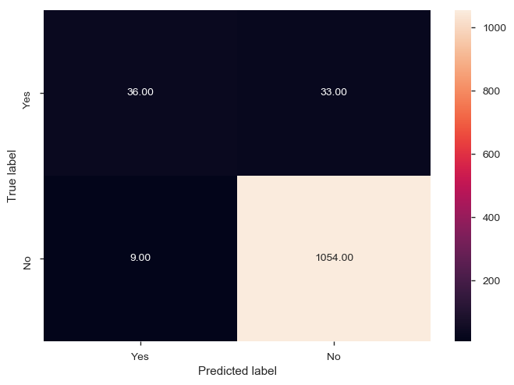
Logistic Regression Model
Model with computation of the missing values with median
Accuracy :0.9628975265017667
Test data
precision recall f1-score support
0 0.97 0.99 0.98 1063
1 0.80 0.52 0.63 69
Model was further fine tuned by choosing the limited features and building the Model. However the accuracy of the Model further reduced and didn’t seem to have any significance

Slide 14
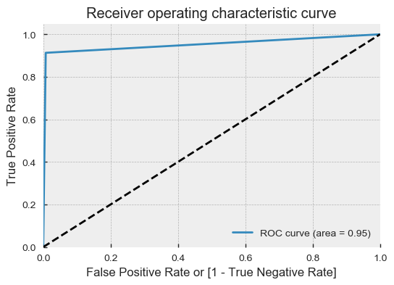
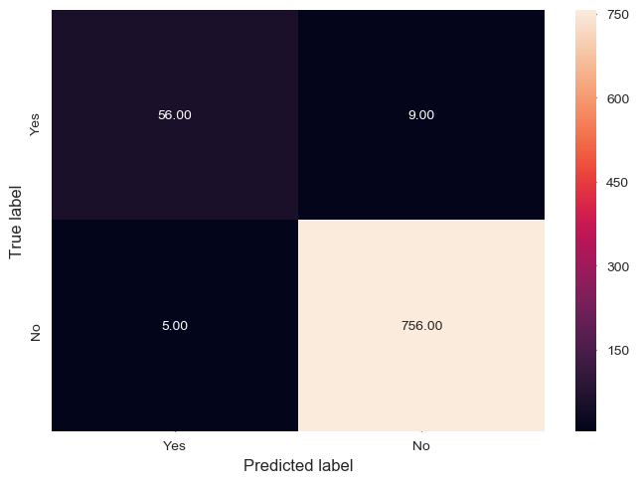
CART MODEL ACCURACY
The model is built using the train data and the prediction is done using the test data, Accuracy of the data is calculated
Accuracy of the Test Data is calculated as 98.03%. 98% accurate in predicting the Thyroid patients and only 5 patients has incorrect prediction

Slide 15
CART Model Tuning
Optimal cut-off for CART Model
Model Calculation | Accuracy | Precision | Recall | ROC
Threshold Value =0.0 | 98.76% | 0.99 | 0.99 | 0.95
Threshold value >0.0 < 0.95 | 98.76% | 0.99 | 0.99 | 0.95
Threshold value = 0.95 | 98.76% | 0.99 | 0.99 | 0.95
Threshold value = 1.0 | 93.904% | 0.93 | 1.0 | 0.50

Slide 16
INSIGHTS & FINDINGS FROM THE MODEL
We can see the improvement in model performance measures based on the different performance measures calculated
Performance Improvement
Model Calculation | Accuracy | Specificity | Sensitivity | ROC
Logistic Regression | 95.52% | 0.82 | 0.99 | 0.77
Logistic Regression – Fine tuning | 96.29% | 0.80 | 0.52 | 0.76
CART model | 98.31% | 0.92 | 0.86 | 0.93
CART model –Fine tuning | 98.76% | 0.89 | 0.91 | 0.95

Slide 17
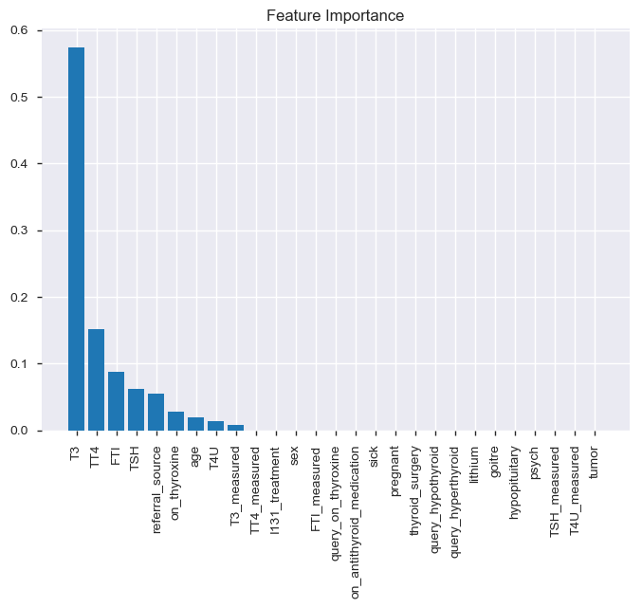
Feature Importance

Slide 18
CONCLUSION
Exploratory Analysis: From EDA, we can conclude that only numerical variables, the hormone levels of T3, T4H, T4U and age are the important factors in predicting Thyroid among the patients
Triiodothyronine(T3) is the most important hormone in predicting Thyroid among patients among the other hormones
CART Model: CART Model provides an accuracy of 98% when the Null values are removed

